Slide 1
Evaluation Methods: Part 3 Synthetic Control
American Society of Criminology
November 14, 2023

Slide 2
Synthetic Control Design
Comparative case study design ⇒ Untreated unit(s) chosen on the basis of subjective similarity to the treated unit (e.g., contiguity)
Interrupted time series with ad hoc comparison units
Question of whether control unit represents the counterfactual trajectory that the treated unit would have experienced in the absence of treatment
In practice, it is impossible to conjure a single untreated unit that approximates the key unobserved characteristics of the treated unit
Synthetic control is a data-driven approach which presumes there is no single unit that suffices for this purpose, and that some combination of units is best suited for comparison

Slide 3
Synthetic Control Design
Weighted combination of control units, from a “donor pool” of potential controls, is selected to resemble the treated unit’s pre-intervention series
Weights are chosen optimally to derive a single, “synthetic” control unit that serves as the counterfactual outcome series (Abadie, 2021; Abadie et al., 2010, 2015; Abadie and Gardeazabal, 2003)
Most important covariates are pre-intervention outcomes, but can also include other covariates
Key to a good synthetic control design is having a lot of pre-intervention time periods and a large, heterogeneous donor pool

Slide 4
Synthetic Control Design
Impact of De-Prosecution on Homicide in Philadelphia

Slide 5
De-Prosecution: Datafile
deprosecution-homicide.csv
Variable | Description
id | Agency ID
ori | Agency ORI number (originating agency identifier)
agency | Agency location
year | Year
murd | Number of murders
rape | Number of forcible rapes
robb | Number of robberies
aggr | Number of aggravated assaults
burg | Number of burglaries
larc | Number of larcenies
moto | Number of vehicle thefts

Slide 6
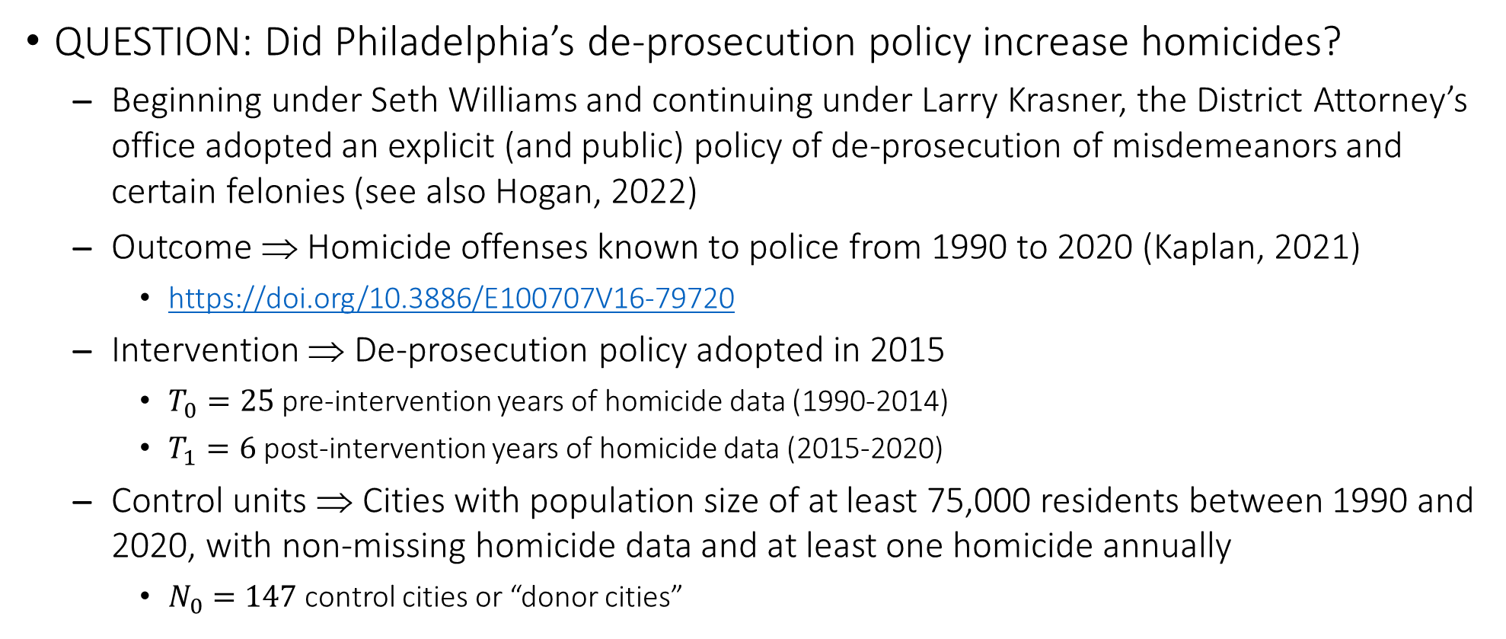
De-Prosecution and City Homicide Rates
QUESTION: Did Philadelphia’s de-prosecution policy increase homicides?
Beginning under Seth Williams and continuing under Larry Krasner, the District Attorney’s office adopted an explicit (and public) policy of de-prosecution of misdemeanors and certain felonies (see also Hogan, 2022)
Outcome ⇒ Homicide offenses known to police from 1990 to 2020 (Kaplan, 2021)
https://doi.org/10.3886/E100707V16-79720
Intervention ⇒ De-prosecution policy adopted in 2015
$T_{0}=25$ pre-intervention years of homicide data (1990-2014)
$T_{1}=6$ post-intervention years of homicide data (2015-2020)
Control units ⇒ Cities with population size of at least 75,000 residents between 1990 and 2020, with non-missing homicide data and at least one homicide annually
$N_{0}=147$ control cities or “donor cities”

Slide 7
De-Prosecution: Load Packages
library(broom)
library(cowplot)
library(fixest)
library(ggrepel)
library(tidysynth)
library(tidyverse)

Slide 8
De-Prosecution: Read in Data
pros <- read_csv("deprosecution-homicide.csv")
names(pros)
## [1] "id" "ori" "agency" "year" "pop" "murd"
## [7] "rape" "robb" "aggr" "burg" "larc" "moto"
## [13] "viol" "prop" "totl"
length(unique(pros$agency))
## [1] 148
To see the full listing of cities, we could type the following:
list(unique(pros$agency))

Slide 9
De-Prosecution: Graph of City Homicide Rates
pros <- pros %>%
mutate(murd.rate = murd / pop * 100000,
post = if_else(year >= 2015, 1, 0),
treated = if_else(agency == "philadelphia PA", 1, 0))
ggplot(pros, aes(x = year, y = murd.rate, group = agency)) + geom_line(color = "darkgray") + geom_line(data = subset(pros, treated == 1), mapping = aes(x = year, y = murd.rate), color = "black", linewidth = 1.5) + geom_vline(xintercept = 2015, linetype = "dashed") + theme_gray(base_size = 15) + labs(x = "Year", y = "Homicide Rate per 100,000", title = "Agency Trends in Homicide, 1990-2020")

Slide 10
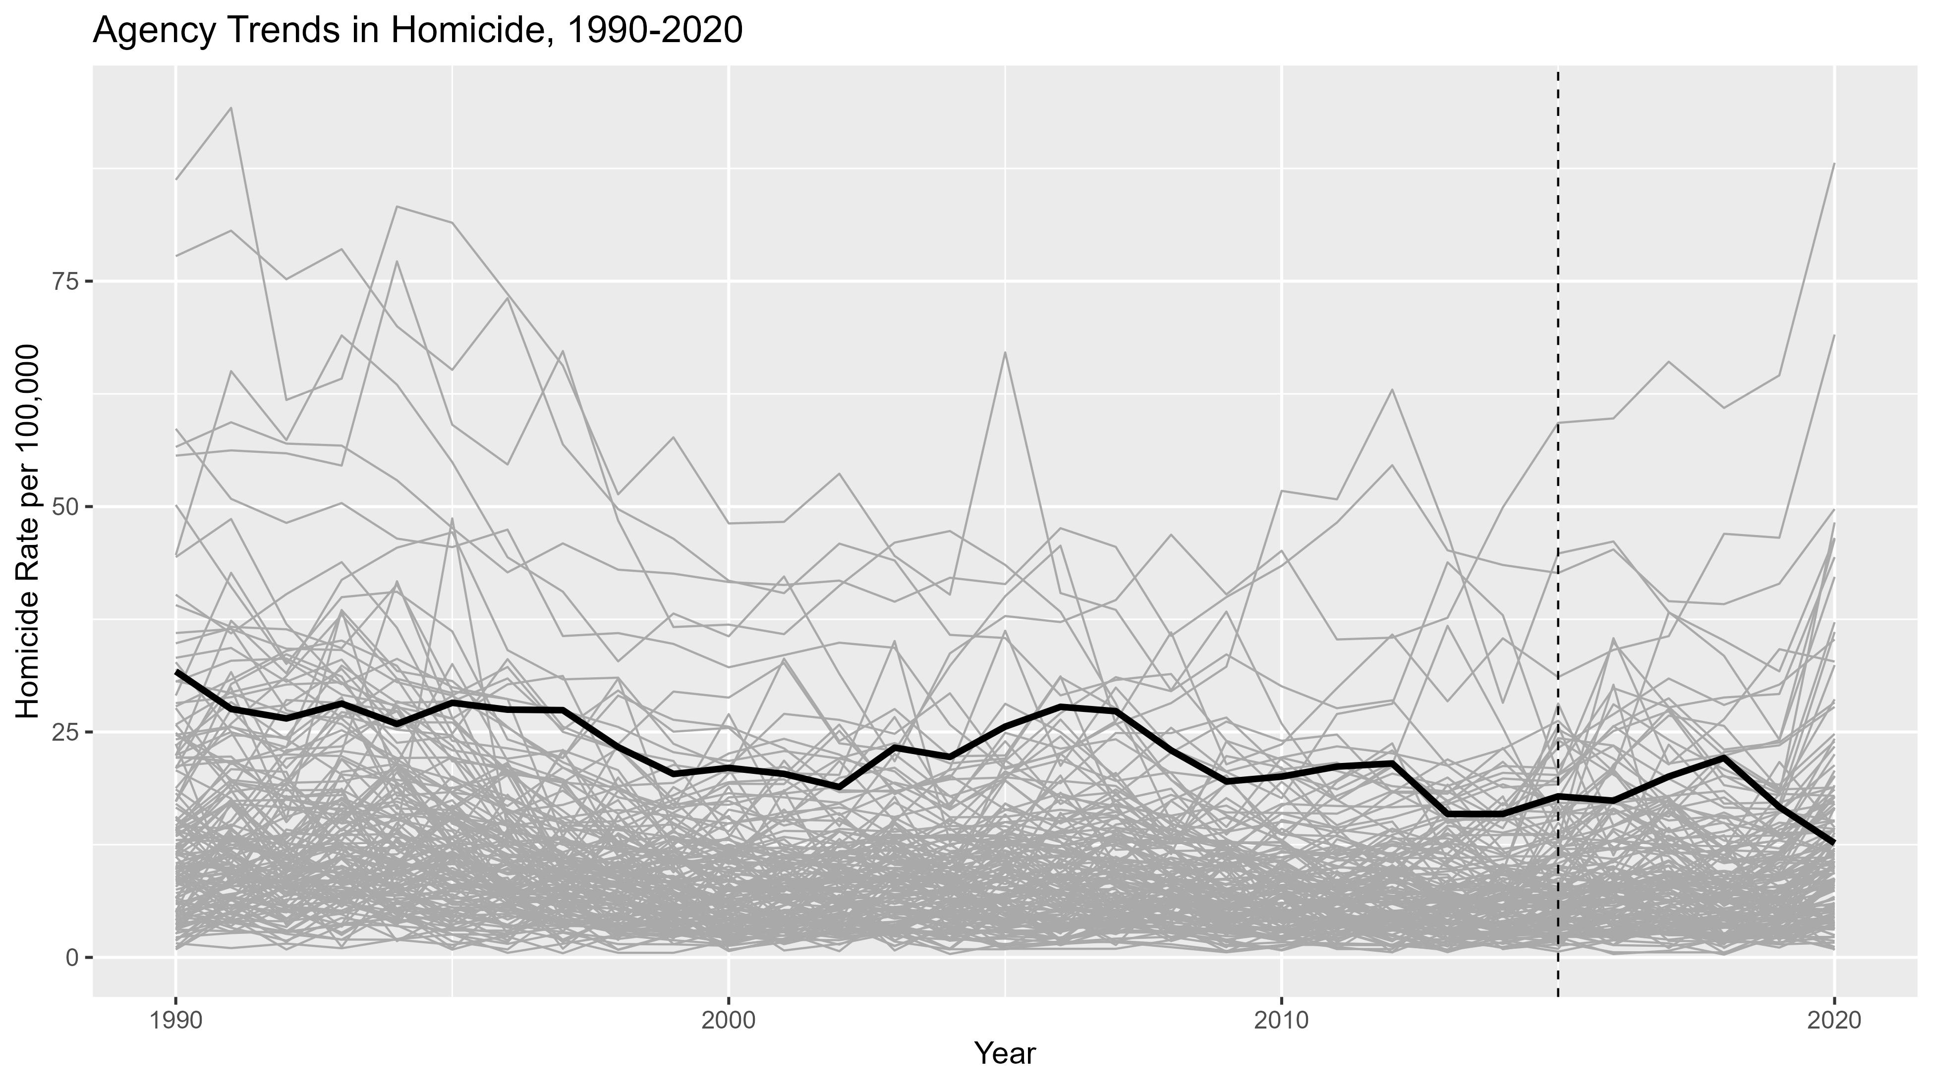
Philadelphia’s homicide trend is shown in bold. There is unclear visual evidence of a de-prosecution effect, since Philadelphia is pretty consistently among cities with a high homicide rate.

Slide 11
De-Prosecution: A TWFE Model for Reference
pros <- pros %>% mutate(tv.treated = treated == 1 & year >= 2015,
year1treated = if_else(treated == 1, 2015, 0),
time1treated = case_when(treated == 1 ~ year - 2015,
TRUE ~ 0))
twfe <- feols(murd.rate ~ tv.treated | agency + year, cluster = ~ agency, data = pros)
twfe.leads <- feols(murd.rate ~ f(tv.treated, 3:0) | agency + year, panel.id = ~ agency + year, cluster = ~ agency, data = pros)
The synthetic control design bears resemblance to the difference-in-differences design. So let’s just estimate two-way fixed effects models and probe the validity of the parallel trends assumption.

Slide 12
De-Prosecution: A TWFE Model for Reference
tidy(twfe)
## # A tibble: 1 × 5
## term estimate std.error statistic p.value
## <chr> <dbl> <dbl> <dbl> <dbl>
## 1 tv.treatedTRUE -4.83 0.449 -10.7 3.08e-20
tidy(twfe.leads)
## # A tibble: 4 × 5
## term estimate std.error statistic p.value
## <chr> <dbl> <dbl> <dbl> <dbl>
## 1 f(tv.treated, 3)TRUE -0.230 0.512 -0.449 6.54e- 1
## 2 f(tv.treated, 2)TRUE -5.29 0.328 -16.2 2.19e-34
## 3 f(tv.treated, 1)TRUE 0.149 0.307 0.485 6.28e- 1
## 4 tv.treatedTRUE 1.03 0.328 3.13 2.08e- 3
The standard TWFE model indicates the homicide rate might actually have fallen in response to the de-prosecution policy, by almost 5 homicides per 100,000. But there is clear evidence that homicide dropped two years beforehand, which makes it tough to attribute the post-intervention drop to the policy itself.

Slide 13
De-Prosecution: A TWFE Model for Reference
twfe.event <- feols(murd.rate ~ i(time1treated, treated, -1) | agency + year, cluster = ~ agency, data = pros)
twfe.event.plot <- data.frame(relt = c(-25:-2, 0:4), b = twfe.event$coefficients, se = twfe.event$se)
twfe.event.plot <- rbind(twfe.event.plot, c(-1, 0, 0))
ggplot(twfe.event.plot, aes(x = relt, y = b)) + geom_vline(xintercept = 0, linetype = "dashed") + geom_hline(yintercept = 0, linetype = "dashed") + geom_pointrange(aes(ymin = b - 2 * se, ymax = b + 2 * se), linewidth = 0.7) + theme_gray(base_size = 15) + theme(legend.position = c(0.85, 0.8)) + labs(x = "Time to De-Prosecution Policy", y = "Estimate of the ATT", title = "Event Study Estimates of the Impact of De-Prosecution on Homicide")

Slide 14
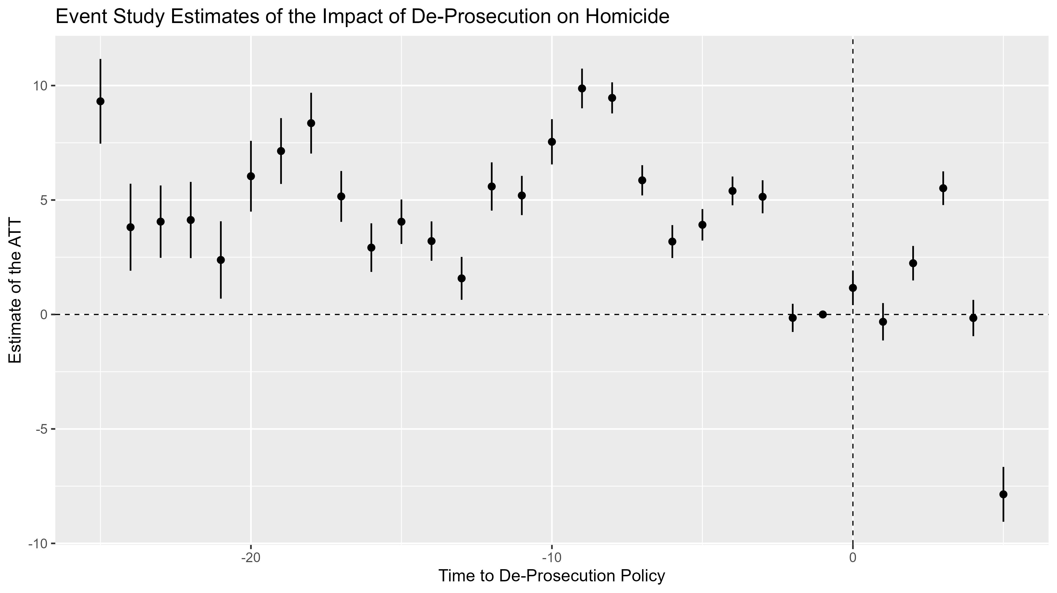
Woof!

Slide 15
Difference in Differences versus Synthetic Control Model
Some features in favor of SCM over DID
DID hinges on a parallel trends assumption, whereas SCM conjures a control unit that effectively matches the time series of the treatment unit prior to treatment, by definition
DID uses the entire pool of control units, whereas SCM draws more heavily from only certain control units via differential weighting
DID is regression-based and requires functional form assumptions and high-dimensional interactions, whereas SCM is non-parametric and inherently dynamic
An important limiting factor of SCM
DID can be estimated with just one or a few pre-treatment time periods, but SCM requires many pre-treatment time periods (in this sense, SCM is more like interrupted time series)

Slide 16
Using R for the Synthetic Control Model
We will string together commands via pipes with the tidysynth package
synthetic_control(outcome = yvar, unit = idvar, time = timevar, i_unit = "id", i_time = #, generate_placebos = T/F)
Initializes the SCM by specifying key information about the data, including the treated unit and time
generate_predictor(time_window = #:#, newvar = funct(covar))
Creates predictors aggregating covariate data to fit the SCM across the pre-intervention time window
Multiple covariates and time windows can be piped together sequentially
generate_weights(optimization_window = #:#)
Creates weights to generate the synthetic control unit over the full pre-intervention time window
generate_control()
Creates the synthetic control unit
A good resource is available at https://github.com/edunford/tidysynth

Slide 17
Using R for the Synthetic Control Model
There are built-in commands to extract data in the tidysynth package
grab_synthetic_control() ⇒ Outcome data for treated and synthetic units over the full time window
grab_balance_table() ⇒ Balance data for the predictors used to fit the SCM
grab_unit_weights() ⇒ Weights assigned to each control unit
grab_significance() ⇒ Fisher’s exact p-values (one-sided) obtained by ranking the mean squared prediction error (MSPE) ratios
Can also be used to obtain the pre-intervention RMSPE, which comes in handy when comparing different specifications of the pre-intervention model

Slide 18
Using R for the Synthetic Control Model
There are also built-in plot functions available in the tidysynth package
plot_trends() ⇒ Plots the outcome series for treated and synthetic units
plot_differences() ⇒ Plots the ATT series (i.e., the difference between the treated and synthetic units at each time period) over the full time window
Visualizes the SCM fit during the pre-intervention period and the time-specific estimate of the ATT during the post-intervention period
plot_placebos() ⇒ Plots all of the placebo ATT series, to visualize the relative rarity of the original ATT series
plot_weights() ⇒ Plots the control unit and predictor variable weights
plot_mspe_ratio() ⇒ Plots the ratio of the pre-intervention mean squared prediction error (MSPE) to the post-intervention MSPE for all ATT trends

Slide 19
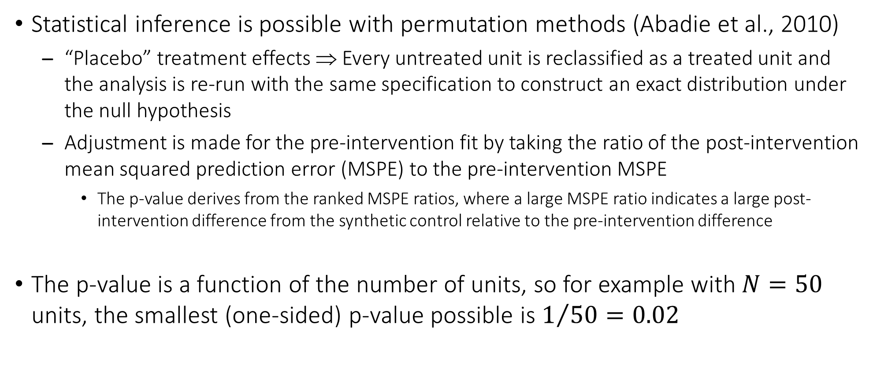
Inference with the Synthetic Control Model
Statistical inference is possible with permutation methods (Abadie et al., 2010)
“Placebo” treatment effects ⇒ Every untreated unit is reclassified as a treated unit and the analysis is re-run with the same specification to construct an exact distribution under the null hypothesis
Adjustment is made for the pre-intervention fit by taking the ratio of the post-intervention mean squared prediction error (MSPE) to the pre-intervention MSPE
The p-value derives from the ranked MSPE ratios, where a large MSPE ratio indicates a large post-intervention difference from the synthetic control relative to the pre-intervention difference
The p-value is a function of the number of units, so for example with $N=50$ units, the smallest (one-sided) p-value possible is $1/{50}=0.02$

Slide 20
De-Prosecution: Fit the Synthetic Control Model
synth <- pros %>%
synthetic_control(outcome = murd.rate,
unit = agency,
time = year,
i_unit = "philadelphia PA",
i_time = 2015,
generate_placebos = T) %>%
generate_predictor(time_window = 1990:2014,
murder = mean(murd.rate)) %>%
generate_weights(optimization_window = 1990:2014) %>%
generate_control()
This fits a basic SCM using just the average of the homicide rate over 1990-2014 to construct the weights. Notice the tidysynth commands are strung together in a single pipeline.

Slide 21
De-Prosecution: Grab the Relevant Results
fit.synth <- grab_synthetic_control(synth)
fit.placebo <- grab_synthetic_control(synth, placebo = T)
fit.wgts <- grab_unit_weights(synth)
fit.mspe <- grab_significance(synth)
We are going to make some graphs, so let’s get the results we wish to visualize.

Slide 22
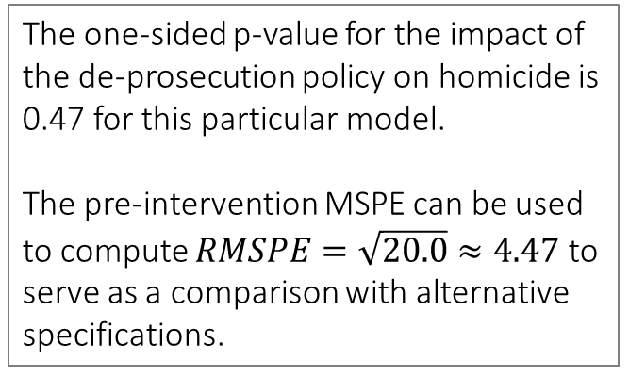
De-Prosecution: Significance of Post-Intervention ATTs
fit.mspe[fit.mspe$unit_name == "philadelphia PA", ]
## # A tibble: 1 × 8
## unit_name type pre_mspe post_mspe mspe_ratio rank fishers_exact_pvalue z_score
## <chr> <chr> <dbl> <dbl> <dbl> <int> <dbl> <dbl>
## 1 philadelphia PA Treated 20.0 22.2 1.11 70 0.473 -0.293
sqrt(fit.mspe[fit.mspe$unit_name == "philadelphia PA", 3])
## # A tibble: 1 × 1
## pre_mspe
## <dbl>
## 1 4.47
The one-sided p-value for the impact of the de-prosecution policy on homicide is 0.47 for this particular model.
The pre-intervention MSPE can be used to compute $RMSPE=\sqrt{20.0}≈4.47$ to serve as a comparison with alternative specifications.

Slide 23
De-Prosecution: Visualize the Synthetic Control Model
a1 <- fit.synth %>% pivot_longer(cols = c("real_y", "synth_y"), names_to = "group", values_to = "outcome") %>% ggplot(aes(x = time_unit, y = outcome, color = group)) + geom_line(linewidth = 1) + geom_vline(xintercept = 2015, linetype = "dashed") + scale_color_discrete(name = "Series", labels = c("Philadelphia", "Synthetic Philadelphia")) + theme_gray(base_size = 15) + theme(legend.position = "top") + labs(x = "Year", y = "Homicide Rate per 100,000", title = "Treated and Synthetic Homicide Series")
b1 <- fit.synth %>% ggplot(aes(x = time_unit, y = real_y - synth_y)) + geom_line(linewidth = 1) + geom_hline(yintercept = 0, linetype = "dashed") + geom_vline(xintercept = 2015, linetype = "dashed") + theme_gray(base_size = 15) + labs(x = "Year", y = "Difference in Homicide Rate per 100,000", title = "Treatment Effect Series")
plot_grid(a1, b1)
Rather than use the built-in plots, let’s create a custom plot of the homicide trends. This object is from grab_synthetic_control(), which generates a data frame including Philadelphia (real_y) and Synthetic Philadelphia (synth_y) by year (time_unit).

Slide 24
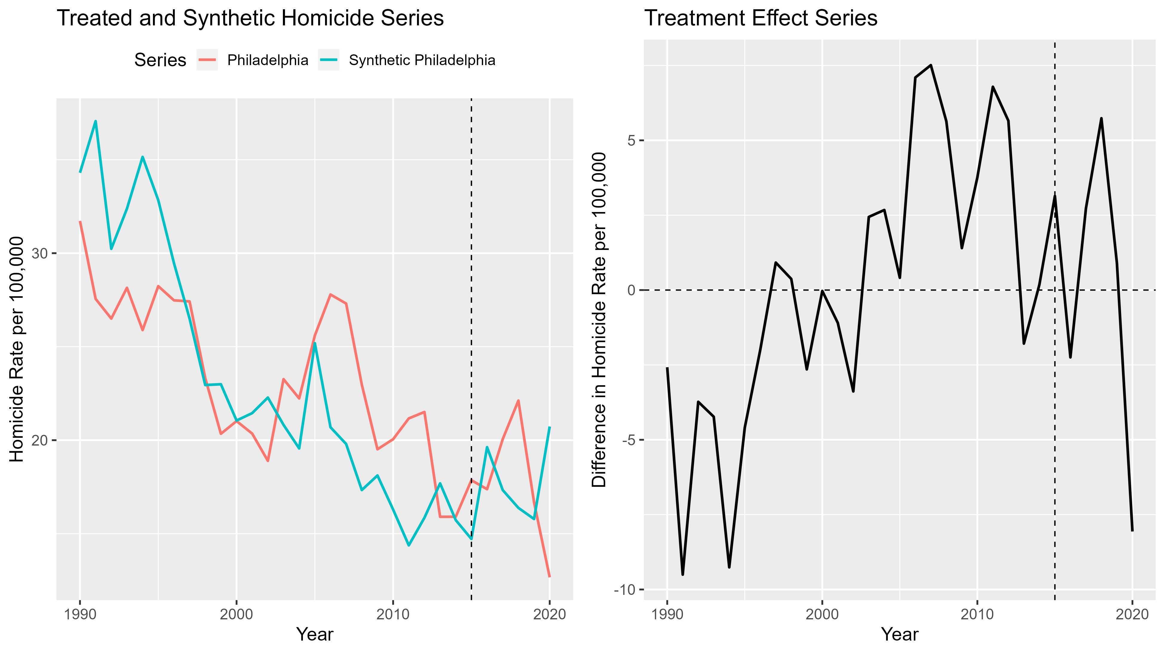
This plot provides the ATT series, but the pre-intervention differences are way too large for this model to be informative.
We would rather see much closer fit between the two series than this.

Slide 25
De-Prosecution: Visualize the Placebo Treatment Series
ggplot(fit.placebo, aes(x = time_unit, y = real_y - synth_y, group = .id)) + geom_line(color = "darkgray") + geom_line(data = subset(fit.placebo, .placebo == 0), mapping = aes(x = time_unit, y = real_y - synth_y), color = "black", linewidth = 1.5) + geom_hline(yintercept = 0, linetype = "dashed") + geom_vline(xintercept = 2015, linetype = "dashed") + theme_gray(base_size = 15) + labs(x = "Year", y = "Difference in Homicide Rate per 100,000", title = "Actual and Placebo Treatment Effect Series")
This object is also from grab_synthetic_control() , but with the placebo = T option. It stacks all of the units and provides the observed homicide series and the synthetic homicide series.

Slide 26
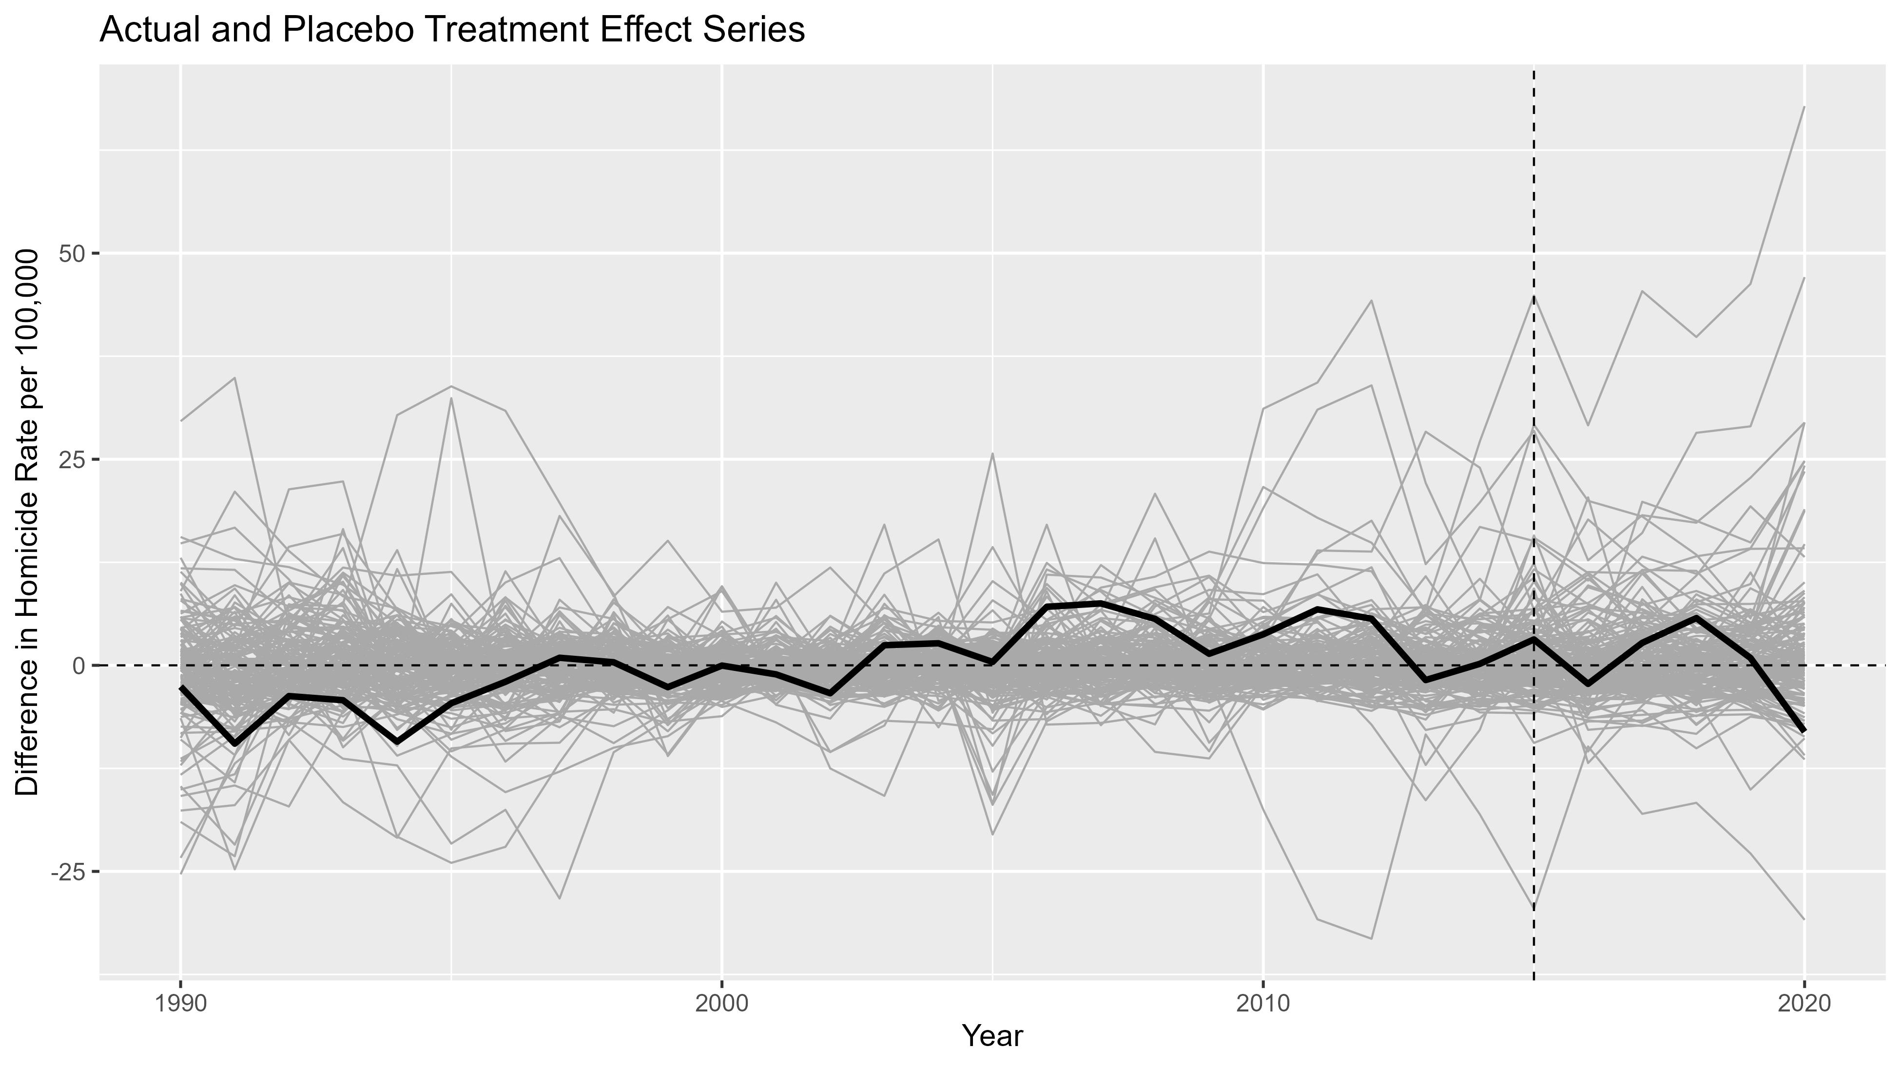
This plot overlays the Philadelphia ATT series onto the placebo ATT series. If the de-prosecution policy has any impact on homicide, the post-intervention Philadelphia ATT series ought to be an outlier. It does not appear to be one.

Slide 27
De-Prosecution: Visualize the Weights and MSPE Ratios
fit.wgts <- fit.wgts %>% mutate(rank = 148 - rank(weight)) %>% arrange(rank)
fit.wgts.lab <- fit.wgts$unit[35:1]
fit.mspe.lab <- fit.mspe$unit_name[35:1]
c1 <- ggplot(subset(fit.wgts, rank <= 35), aes(x = as.factor(rev(rank)), y = weight)) + geom_col() + coord_flip() + scale_x_discrete(labels = fit.wgts.lab) + theme_gray(base_size = 15) + labs(x = element_blank(), y = "Weight", title = "Unit Weights in Synthetic Control")
d1 <- ggplot(subset(fit.mspe, rank <= 35), aes(x = as.factor(rev(rank)), y = mspe_ratio)) + geom_col() + coord_flip() + scale_x_discrete(labels = fit.mspe.lab) + theme_gray(base_size = 15) + labs(x = element_blank(), y = "Post-Intervention MSPE / Pre-Intervention MSPE", title = "Mean Squared Prediction Error Ratios")
plot_grid(c1, d1)
We cannot include all 147 control cities in a graph, so this program ranks the unit weights and MSPE ratios, and selects the top 35 for visualization.

Slide 28
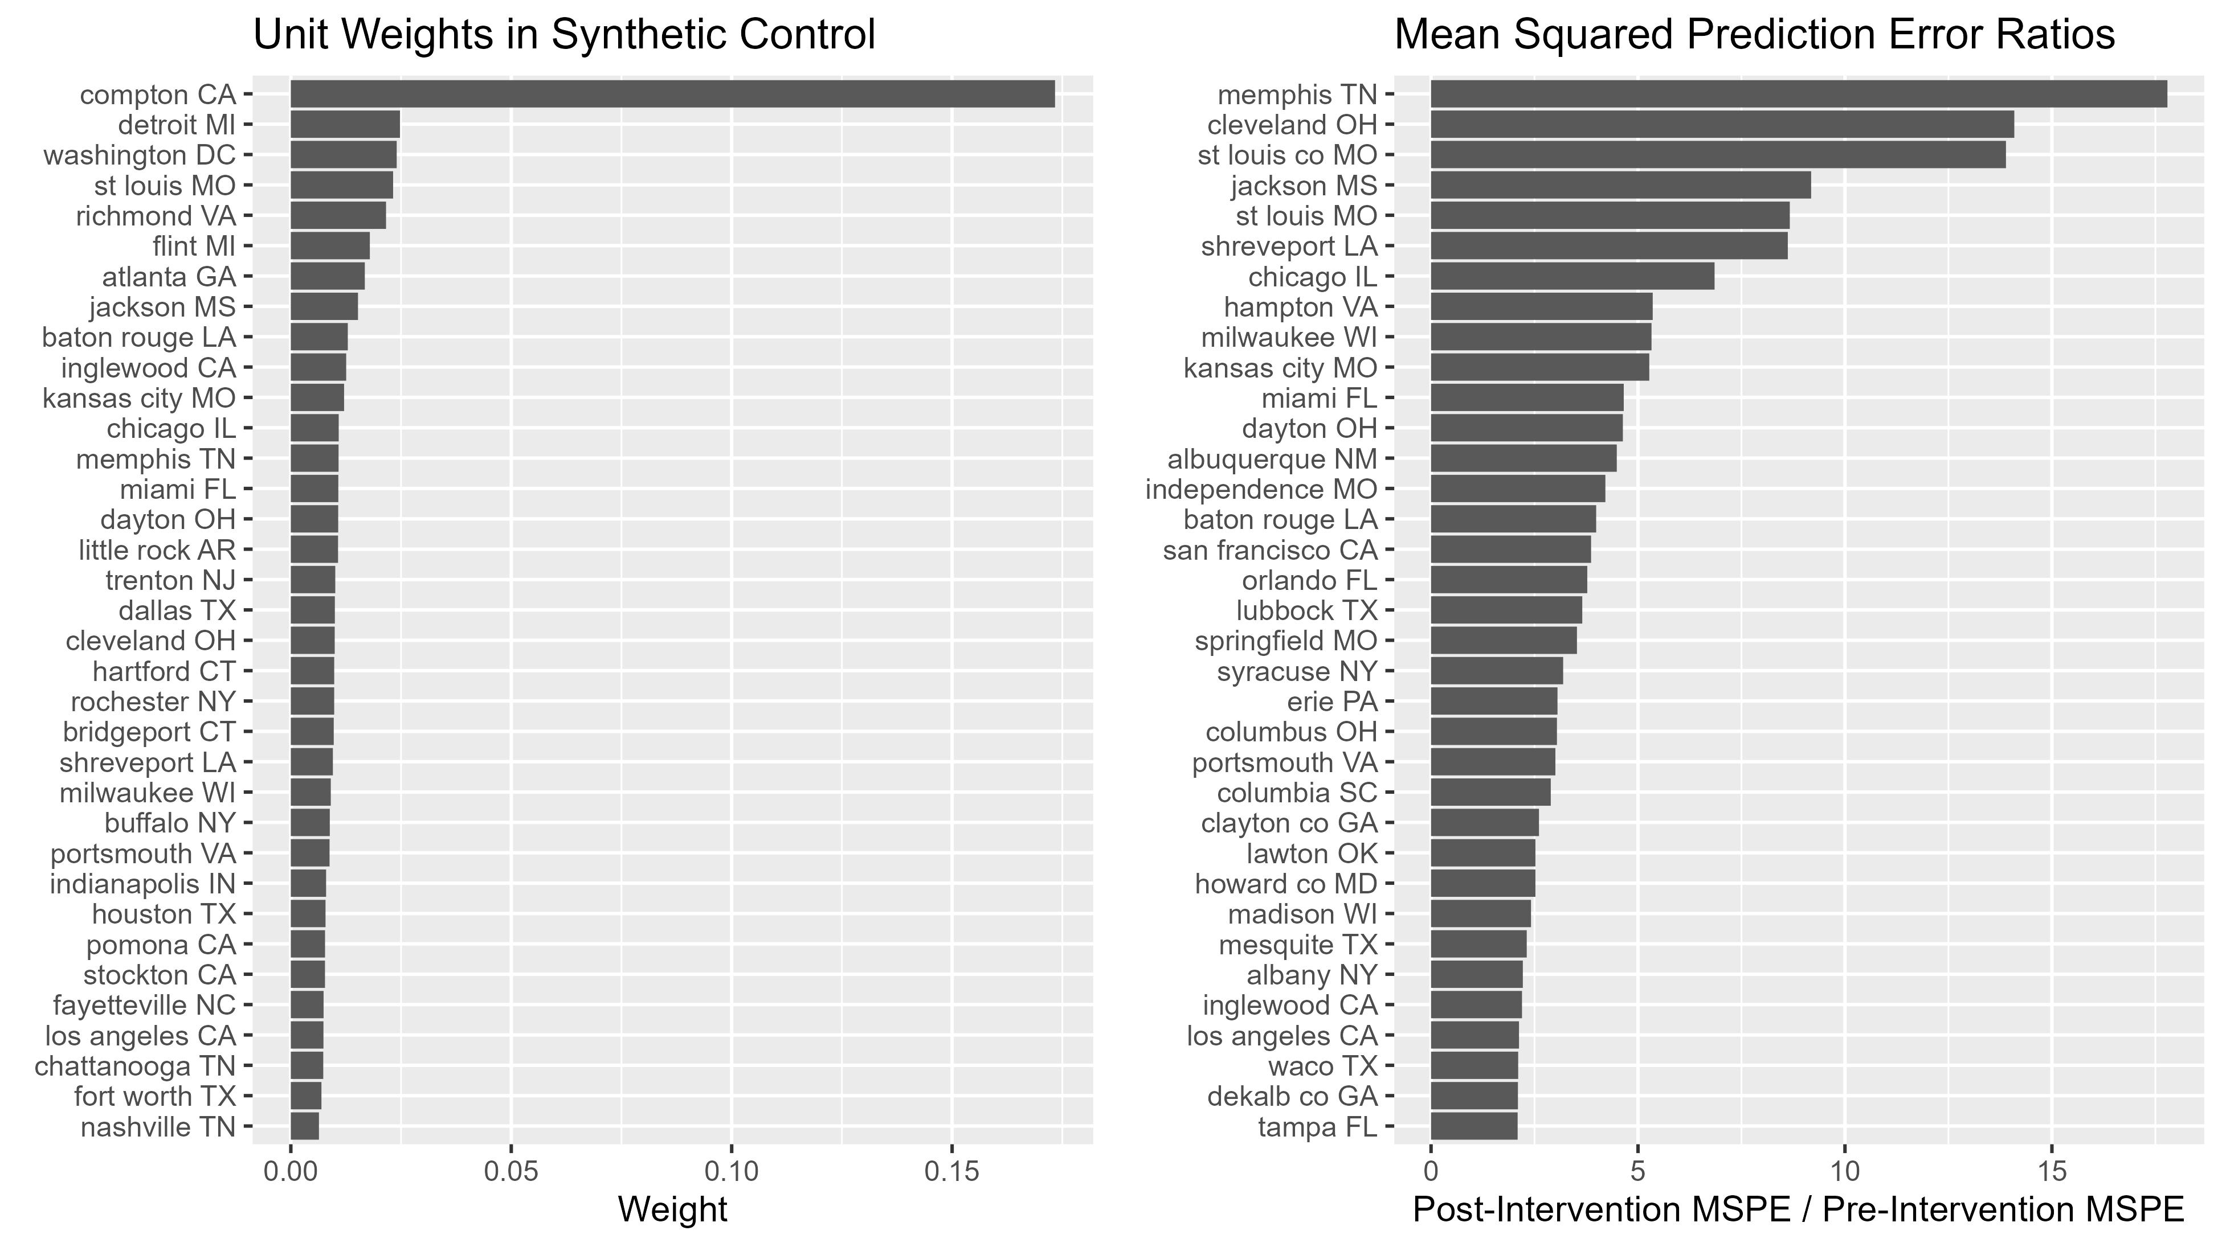
The MSPE ratio is a measure of the statistical significance of the ATT, and the basis of a p-value. Philadelphia should be ranked toward the top if we are to conclude that de-prosecution had any impact on homicide. It is ranked 70, as we already saw.
These are weights assigned to each control city in Synthetic Philadelphia. We can see Compton dominate, but all 147 cities contribute just a little bit.

Slide 29
De-Prosecution: Make Refinements to the SCM
synth2 <- pros %>%
synthetic_control(outcome = murd.rate,
unit = agency,
time = year,
i_unit = "philadelphia PA",
i_time = 2015,
generate_placebos = T) %>%
generate_predictor(time_window = 1990:2014, murd = mean(murd.rate)) %>%
generate_predictor(time_window = 2006, murd06 = murd.rate) %>%
generate_predictor(time_window = 2011:2013, murd11_13 = mean(murd.rate)) %>%
generate_weights(optimization_window = 1990:2014) %>%
generate_control()
In the refined model, we will try to balance the homicide rate in the years leading up to the de-prosecution policy. This specification selects 2006 and the mean from 2011-2013.

Slide 30
De-Prosecution: Assessing Improvement in Model Fit
fit2.mspe <- grab_significance(synth2)
sqrt(fit2.mspe[fit2.mspe$unit_name == "philadelphia PA", 3])
## # A tibble: 1 × 1
## pre_mspe
## <dbl>
## 1 2.46
fit2.mspe[fit2.mspe$unit_name == "philadelphia PA", ]
## # A tibble: 1 × 8
## unit_name type pre_mspe post_mspe mspe_ratio rank fishers_exact_pvalue z_score
## <chr> <chr> <dbl> <dbl> <dbl> <int> <dbl> <dbl>
## 1 philadelphia PA Treated 6.03 41.4 6.87 7 0.0473 1.38
The RMSPE declines 45% from 4.47 to 2.46, indicating an improvement in fit. The one-sided p-value for the impact of de-prosecution is now less than 0.05, which implies the ATT in Philadelphia is at least marginally significant.

Slide 31
De-Prosecution: Visualize the Refined Model
fit2.synth <- grab_synthetic_control(synth2)
a2 <- fit2.synth %>% pivot_longer(cols = c("real_y", "synth_y"), names_to = "group", values_to = "outcome") %>% ggplot(aes(x = time_unit, y = outcome, color = group)) + geom_line(linewidth = 1) + geom_vline(xintercept = 2015, linetype = "dashed") + scale_color_discrete(name = "Series", labels = c("Philadelphia", "Synthetic Philadelphia")) + theme_gray(base_size = 15) + theme(legend.position = "top") + labs(x = "Year", y = "Homicide Rate per 100,000", title = "Treated and Synthetic Homicide Series")
b2 <- fit2.synth %>% ggplot(aes(x = time_unit, y = real_y - synth_y)) + geom_line(linewidth = 1) + geom_hline(yintercept = 0, linetype = "dashed") + geom_vline(xintercept = 2015, linetype = "dashed") + theme_gray(base_size = 15) + labs(x = "Year", y = "Difference in Homicide Rate per 100,000", title = "Treatment Effect Series")
plot_grid(a2, b2)

Slide 32
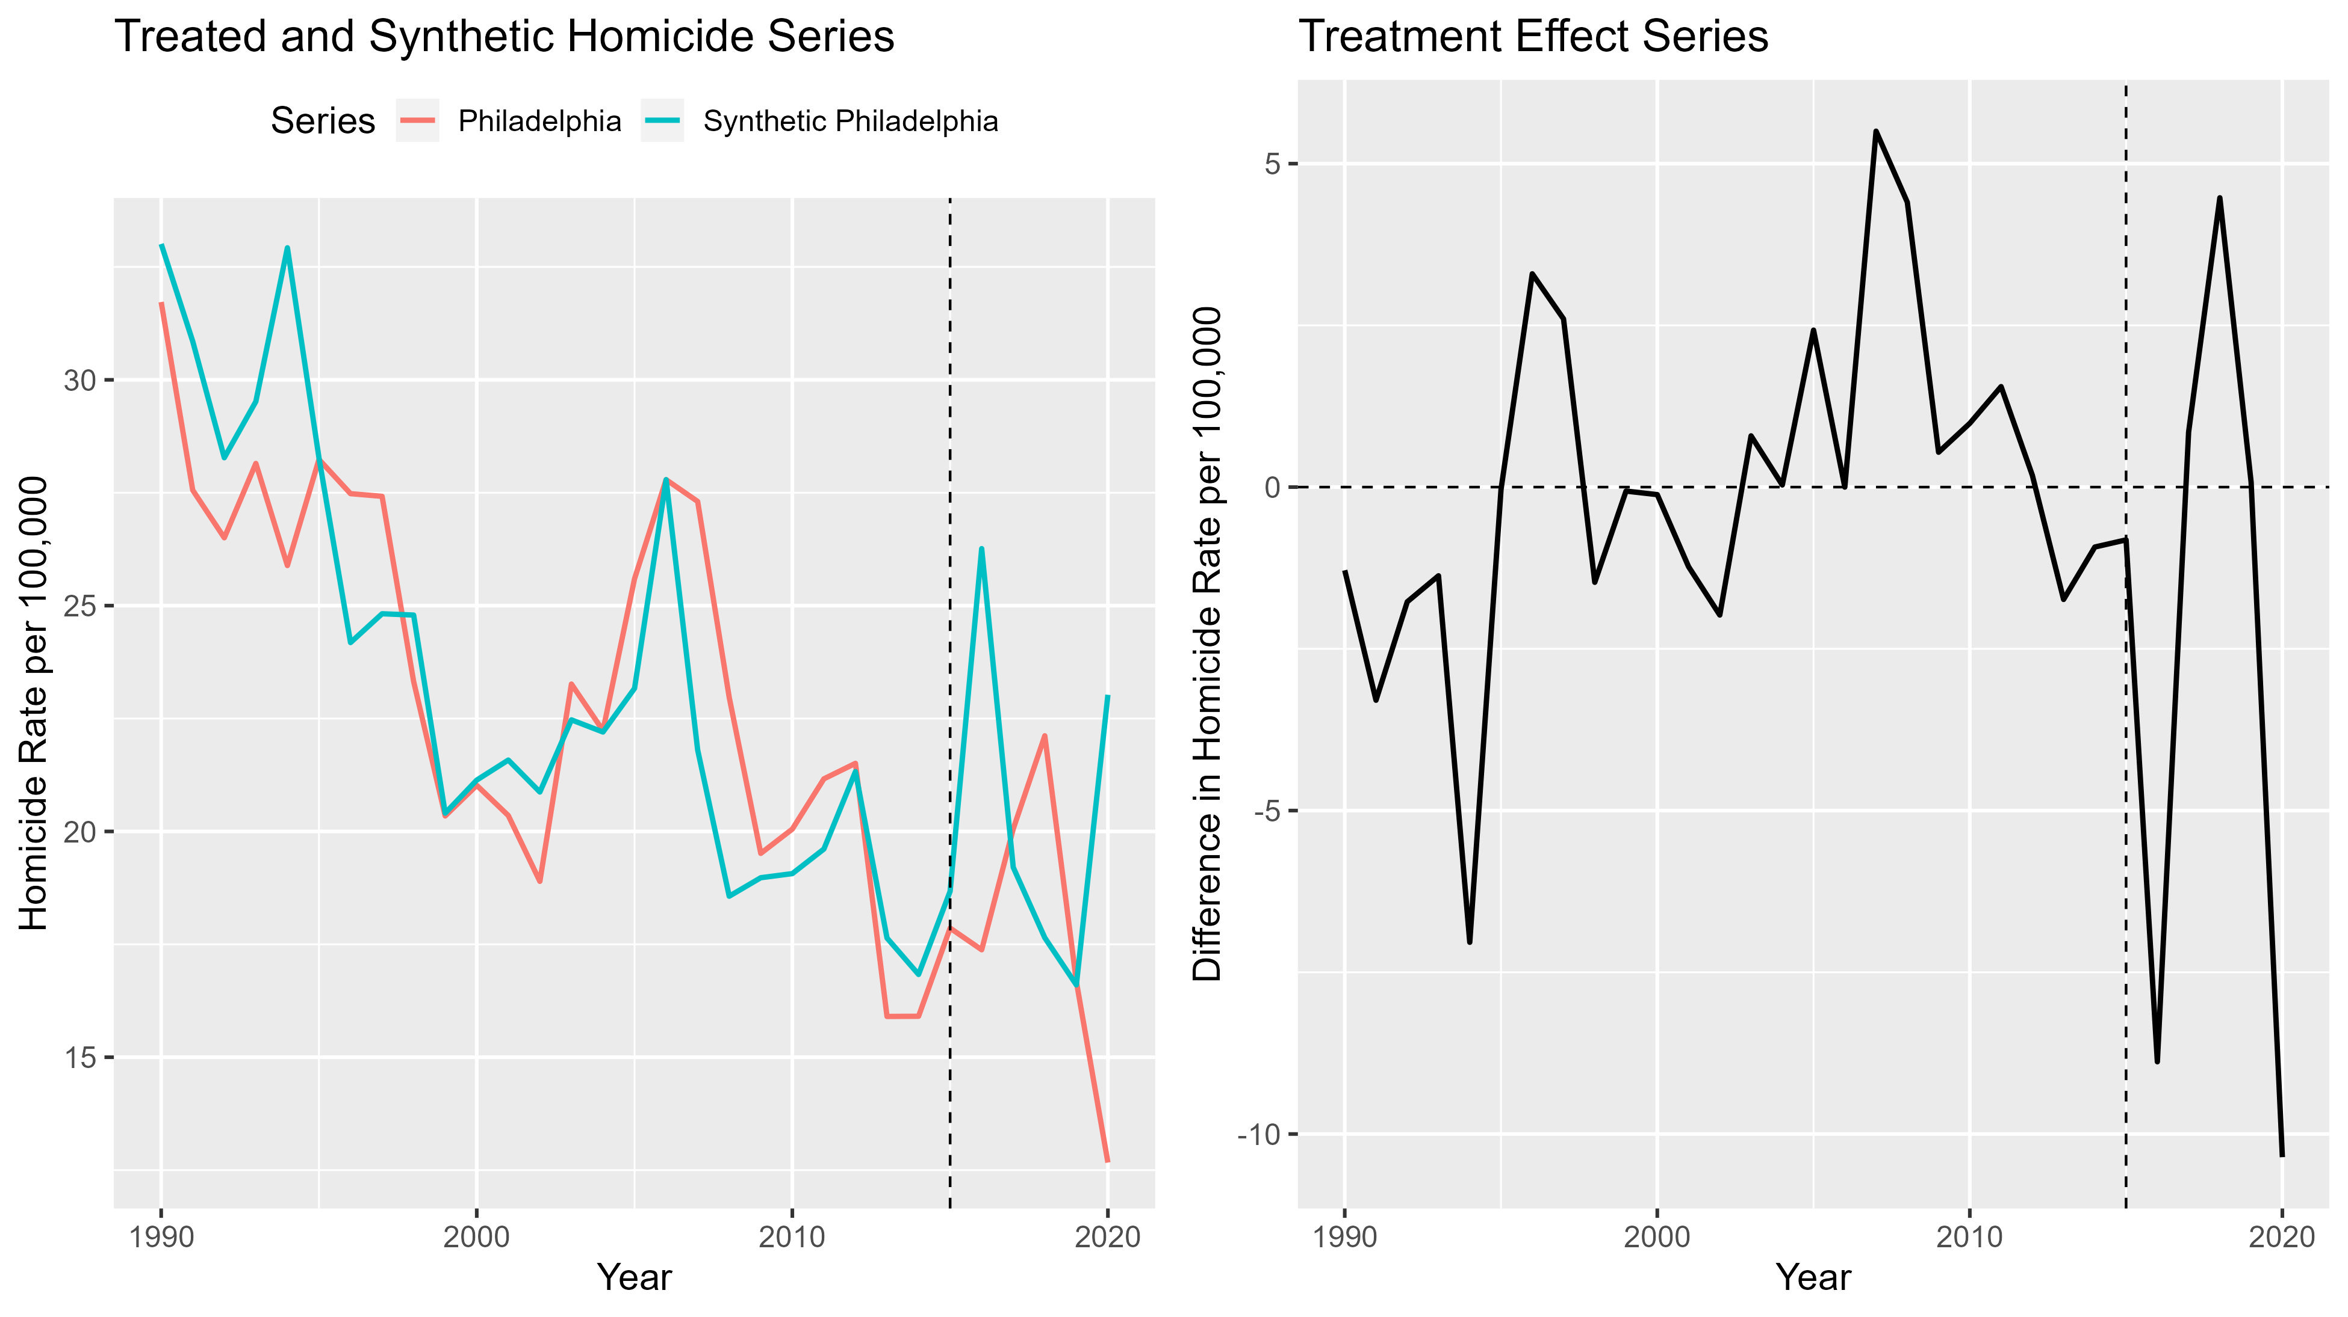
There is certainly less volatility than before in the pre-intervention series, but there are still some large too-large discrepancies and evidence of a pre-intervention trend.
This is a much better fit, especially in the last several years leading up to the de-prosecution policy.

Slide 33
De-Prosecution: Identify the SCM-Selected Control Units
fit2.wgts <- grab_unit_weights(synth2)
fit2.wgts <- fit2.wgts %>% mutate(rank = 148 - rank(weight)) %>% arrange(rank)
fit2.wgts$weight[fit2.wgts$rank <= 10]
## [1] 0.284188542 0.148598373 0.119050751 0.101555474 0.067324635
## [6] 0.007029201 0.006991064 0.006171611 0.006070244 0.005409647
fit2.wgts$unit[fit2.wgts$rank <= 10]
## [1] "orlando FL" "richmond VA" "detroit MI" "inglewood CA" "flint MI"
## [6] "baton rouge LA" "st louis MO" "kansas city MO" "dayton OH" "rochester NY"

Slide 34
De-Prosecution: Graph the SCM-Selected Series
labels <- pros %>% filter(agency == "philadelphia PA" | agency == "orlando FL" | agency == "richmond VA" | agency == "detroit MI" | agency == "inglewood CA" | agency == "flint MI") %>% group_by(agency) %>% summarize(pos = which.max(year), x = year[pos], y = murd.rate[pos])
ggplot(subset(pros, agency == "philadelphia PA" | agency == "orlando FL" | agency == "richmond VA" | agency == "detroit MI" | agency == "inglewood CA" | agency == "flint MI"), aes(x = year, y = murd.rate, group = agency, color = agency)) + geom_line(mapping = aes(size = treated)) + geom_vline(xintercept = 2015, linetype = "dashed") + geom_label_repel(data = labels, aes(x = x, y = y, label = agency), min.segment.length = 0, direction = "y", nudge_x = 5, hjust = 0) + scale_color_viridis_d() + scale_size(range = c(0.8, 2), guide = "none") + theme_gray(base_size = 15) + theme(legend.position = "none") + labs(x = "Year", y = "Homicide Rate per 100,000", title = "SCM-Selected Agency Trends in Homicide, 1990-2020")
We will select out Philadelphia and the five major control cities with non-trivial weight assigned by the SCM. We will just plot those homicide rate series to compare directly.

Slide 35
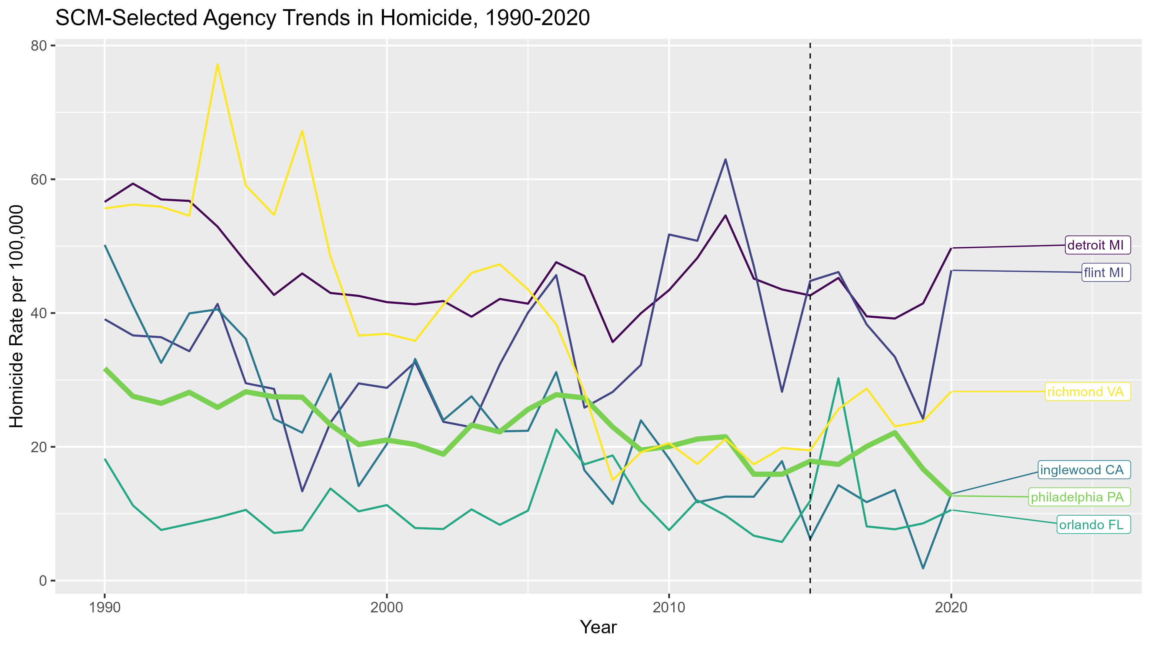
With the SCM-selected cities singled out, it is a little easier to imagine how the weighting works. But we also want to establish face validity for the selections.

Slide 36
De-Prosecution: Estimate the Total Treatment Effect
fit2.att <- fit2.synth$real_y[fit2.synth$time_unit >= 2015] - fit2.synth$synth_y[fit2.synth$time_unit >= 2015]
round(fit2.att, 2)
## [1] -0.82 -8.88 0.85 4.47 0.08 -10.36
mean(fit2.att)
[1] -2.443078
sum(fit2.att)
## [1] -14.65847
This program selects out the observed and synthetic homicide rates from 2015-2020 in Philadelphia. These are the year-by-year estimates of the ATT, which can be averaged or added up.
The de-prosecution policy is followed by about 2.5 fewer homicides per year, with a total of almost 15 fewer homicides. Considering Philadelphia is a city of 1.5 million, 15 fewer homicides per 100,000 is roughly 225 people.

Slide 37
Summary of the Synthetic Control Model
De-prosecution might have actually reduced homicide in Philadelphia
Our refined model suggests that, if anything, de-prosecution was followed by an overall decline in homicide, and the permutation test indicates it is marginally significant
We would continue to refine the model to improve fit (and maybe add other covariates)
Sensitivity analyses would include (1) an in-time placebo test where we back up the intervention date, and (2) leave-one-out robustness where we remove the control units which contribute to the synthetic control one at a time
Synthetic control models have lots of researcher degrees of freedom and require great care and more than a couple of pre-intervention time periods

Slide 38
References
Abadie, Alberto. 2021. Using synthetic controls: Feasibility, data requirements, and methodological aspects. Journal of Economic Literature 59: 391–425.
Abadie, Alberto, Alexis Diamond, and Jens Hainmueller. 2010. Synthetic control methods for comparative case studies: Estimating the effect of California’s tobacco control program. Journal of the American Statistical Association 105: 493–505.
Abadie, Alberto, Alexis Diamond, and Jens Hainmueller. 2015. Comparative politics and the synthetic control method. American Journal of Political Science 59: 495–510.
Abadie, Alberto, and Javier Gardeazabal. 2003. The economic costs of conflict: A case study of the Basque country. American Economic Review 93: 113–132.
Hogan, Thomas P. 2022. De-prosecution and death: A synthetic control analysis of the impact of de-prosecution on homicides. Criminology and Public Policy 21: 489–534.
Kaplan, Jacob. 2021. Jacob Kaplan’s Concatenated Files: Uniform Crime Reporting Program Data: Offenses Known and Clearances by Arrest, 1960-2019. Ann Arbor, MI: Inter-university Consortium for Political and Social Research [distributor], 2021-01-16. https://doi.org/10.3886/E100707V16-79720.

